Slide 1



overall_1_132573879104528179 columns_1_132573879104528179
Microsoft Office Add-ins
Community call
One Outlook
Outlook Smart Alerts demo
Blazor with Excel add-in demo
June 8, 2022

Slide 2
Agenda
One Outlook
Outlook Smart Alerts demo
Blazor with Excel add-in demo
Nikita Mittal
Sam Ramon
Maarten van Stam
Senior Product Manager
Technical Writer
MVP Office Add-ins

Slide 3
One Outlook
Nikita Mittal: Senior Product Manager

Slide 4
Overview
We are unifying our code base to simplify things for customers and ourselves and increase engineering velocity.
One Outlook is OWA code in a native frame
Notes:
We this an opportunity to (a) deliver a consistent experience across platforms to our customers and (b) accelerate Design and Engineering velocity with agility of OWA

Slide 5
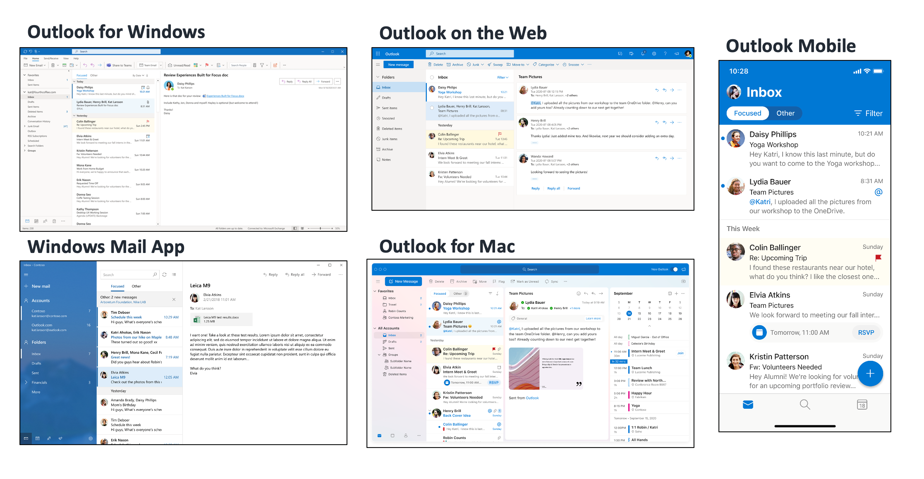
Different Clients for Outlook Today

Slide 6
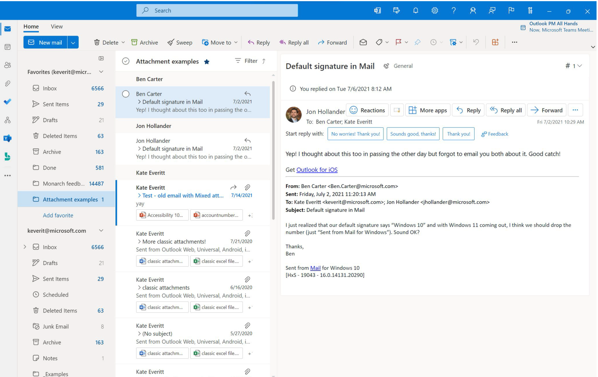
One Outlook

Slide 7
Web Add-Ins on One Outlook
One Outlook will be available only on Windows right now and we plan to expand it to other platforms soon.
Web Add-ins will soon be fully supported on the new Outlook for Windows with no additional work required from partners.
COM Add-ins will not be supported in the new Outlook for Windows. We are actively working to bring Web Add-in capabilities at par with COM Add-ins, so partners can support different scenarios with the web Add-in's advantages of a modern, cross-platform and robust integration.
Platform gaps will be bridged over time and till then you will have the ability to use the old client if you have COM add-ins. Please share any feedback on scenarios that are not supported for you or your partners through Web Add-ins today.

Slide 8
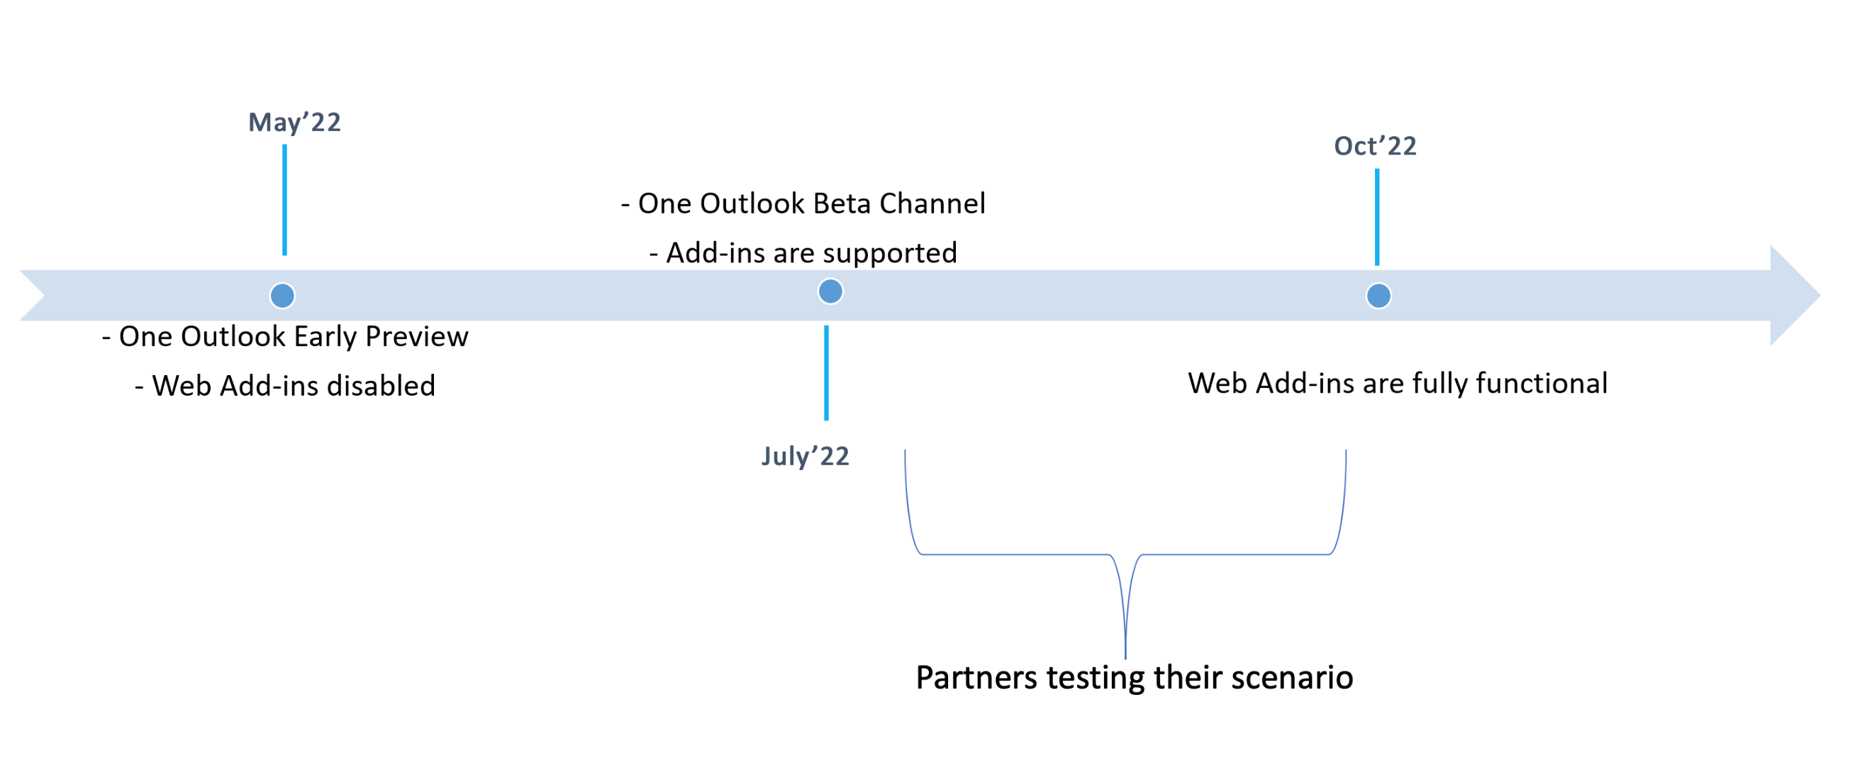
Tentative Timelines

Slide 9
Demo: Outlook Smart Alerts
Sam Ramon: Technical Writer

Slide 10
Outlook Smart Alerts
Event-based activation feature that allows logic to run after a user selects Send from an ​Outlook message or appointment.
Activated by the OnMessageSend and OnAppointmentSend events.
Sample scenarios include:
Verifying that the correct signature is used.
Verifying that a sensitivity label is applied.
Verifying that the correct color categories are applied.
Feature is currently in preview on Windows.

Slide 11
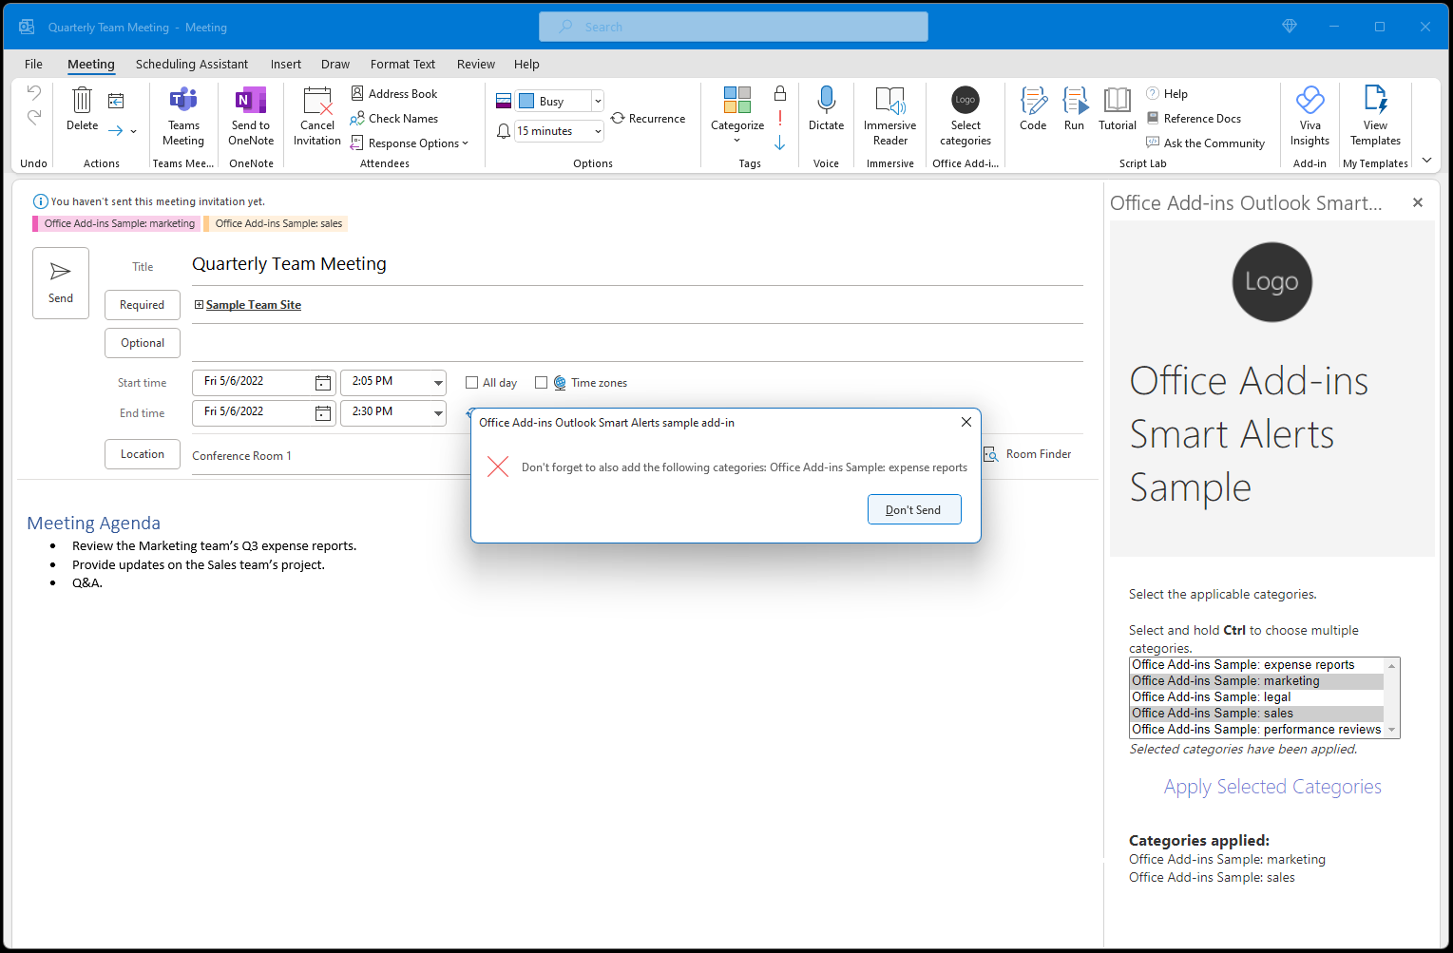
Outlook Smart Alerts Office Add-ins sample
Verifies that required color categories are applied to a new message or appointment before it's sent.
Required categories are based on specific keywords in the message or appointment's subject and body.
Uses the SoftBlock SendMode option for messages and Block for appointments.
Sample: https://github.com/OfficeDev/Office-Add-in-samples/tree/main/Samples/outlook-check-item-categories

Slide 12
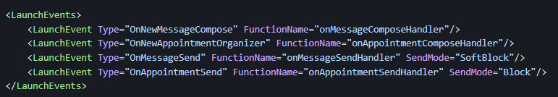
Key parts of the manifest
Uses the <LaunchEvents> element in the manifest.
Three SendMode options available.
PromptUser
SoftBlock
Block

Slide 13
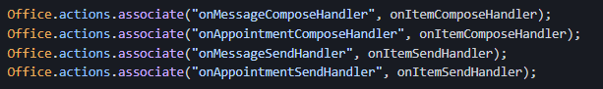
Key parts of the event handler
Uses the Office.actions.associate method to register the event handlers.
Calls the event.completed method to indicate handler code completion.

Slide 14
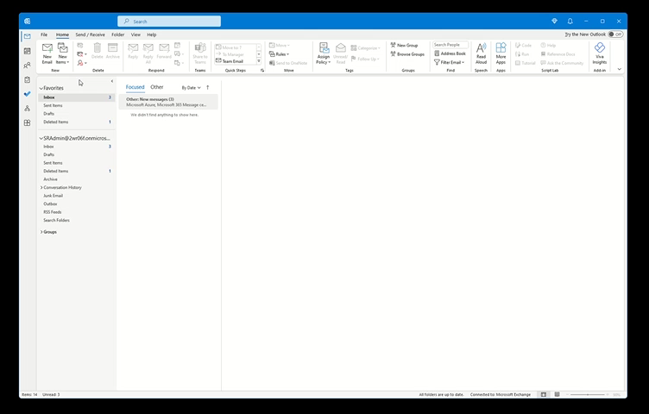

Slide 15
Use Smart Alerts and the OnMessageSend and OnAppointmentSend events in your Outlook add-in (preview)
LaunchEvent in the manifest file
Outlook Smart Alerts Office Add-ins sample
Configure your Outlook add-in for event-based activation
Resources

Slide 16
Demo: Blazor in Excel add-in
Maarten van Stam: MVP Office Add-ins

Slide 17


Community spotlight
Thank you!
Maarten van Stam
https://github.com/OfficeDev/Office-Add-in-samples
https://pnp.github.io/recognitionprogram/

Slide 18
Community panels
Panel | Link
Outlook add-ins | https://ux.microsoft.com/Panel/OutlookAddinDeveloper
Excel add-ins | https://ux.microsoft.com/Panel/ExcelAddinDeveloper
Word add-ins | https://ux.microsoft.com/Panel/WordAddinDeveloper
PowerPoint add-ins | https://ux.microsoft.com/Panel/PowerPointAddinDeveloper
Samples and docs | https://ux.microsoft.com/Panel/OfficeAddinImproveSamplesDocs

Slide 19
Samples and docs panel
June 15th 8am PT (next Wednesday)
Please join us and let us know what you need most from samples for Office Add-ins.
https://aka.ms/officeaddinsamples-join

Slide 20
Is there a way to create spell-checking add-ins? We are currently trying to create some spellcheckers for small languages not supported officially by Microsoft. Is there a way to include them via office.js on all platforms and applications?
Answer:
This depends on what features you want to support. For example, you can't integrate with the built-in spellchecker to scan as the user types. But you can read document content, spellcheck it, and write document content with corrections. You can create one add-in for Word, Excel, and PowerPoint. For more information on how to configure multiple hosts in the manifest, see Specify Office applications and API requirements. Also take a look at the Script Lab manifest which supports multiple hosts. You'll need to create a separate add-in for Outlook.
If you need more information please let us know more about your scenario at either
https://aka.ms/office-addins-dev-questions
[office-js-dev] [office-addins-dev]
- or -
https://stackoverflow.com
[office-js] [outlook-web-addins] [office-scripts]
Q&A

Slide 21
What plan is there for additional Events in Excel that will substantially improve its potential as a development platform? For example, Hyperlink clicked, Defined Name changed, Shape on-hover, etc...
Answer:
These Excel events are not on our roadmap. Please let us know more about your scenarios for these events by creating an idea request at https://aka.ms/m365dev-suggestions.
Q&A

Slide 22
Any update on improving the Office Add-in Ideas Management system?
Answer:
Yes, we are looking to move to GitHub, but the plan is not finalized. For now please continue submitting ideas at the current site at https://aka.ms/m365dev-suggestions. We'll provide an update on the next community call.
Q&A

Slide 23



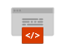


New to Office Add-ins?
 | Documentation | https://aka.ms/office-add-ins-docs
 | Quick starts | Outlook, Excel, Word, PowerPoint
 | Script Lab | https://aka.ms/getscriptlab
 | Samples | https://aka.ms/officeaddinsamples
 | Microsoft 365 Developer Program | https://aka.ms/M365devprogram
 | Office Scripts | aka.ms/office-scripts-docs
Notes:
m365-dev-sig

Slide 24
Engage with the team
Engagement | Where to go
Technical questions about Office Add-ins | https://aka.ms/office-addins-dev-questions [office-js-dev] [office-addins-dev] https://stackoverflow.com [office-js] [outlook-web-addins] [office-scripts]
Product bugs | https://github.com/OfficeDev/office-js
Feature requests and ideas | https://aka.ms/m365dev-suggestions
Send a Smile or Frown | Inside Office
Notes:
m365-dev-sig

Slide 25
Microsoft 365 developer community calls
Microsoft 365 platform call (weekly) https://aka.ms/m365-dev-call
Adaptive Cards (monthly) https://aka.ms/adaptivecardscommunitycall
Microsoft identity platform (monthly) https://aka.ms/IDDevCommunityCalendar
Office Add-ins (monthly) https://aka.ms/officeaddinscommunitycall
PowerApps (monthly) https://aka.ms/PowerAppsMonthlyCall
Microsoft 365 Community (bi-weekly) https://aka.ms/m365-dev-sig
SharePoint Framework (bi-weekly) https://aka.ms/spdev-spfx-call
All calls and assets: https://aka.ms/m365pnp
Notes:
m365-dev-sig

Slide 26
Thank you
Recording will be available in 24 hours on
Microsoft 365 Community (PnP) YouTube channel
https://aka.ms/M365PnP/videos
(subscribe today)
Follow us on Twitter
@Microsoft365Dev | @M365PnP
Next call: July 13th at 8:00 AM Pacific Time
https://aka.ms/officeaddinscommunitycall
Agenda: https://aka.ms/officeaddinsagenda
Submit your questions: https://aka.ms/officeaddinsform

